Slide 1
Reviving the Zombie Reader
Using active reading to engage readers
and build comprehension strategies

Slide 2
How do we engage readers?
Provide strategy instruction to help readers make sense of what they are reading
Don’t assume students know how to approach difficult texts
Incorporate tools that allow students to interact with the text
Show students how to talk to the text
Use explicit instruction
Make invisible thought process visible for students

Slide 3
Purpose
First step in building meta-cognitive strategies.
Help students
understand they are creating meaning when they read
use strategies to gain meaning from texts
recognize strategic readers use multiple strategies.

Slide 4
Activity
Read the passage labeled hand-out 1.
As you read, use two different highlighters.
Choose one color to highlight what you understand in the passage.
Choose a different color to highlight what you don’t understand in the passage.
Make notes on the passage to explain your thinking.
You will share your thinking in a few minutes.

Slide 5
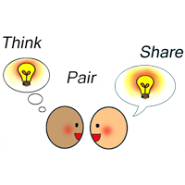
Think-Pair Share
Take a moment to think about what you did to gain meaning from this text.
Turn to a partner and each take a turn talking about your thinking.
Partner groups will share in a few minutes.

Slide 6
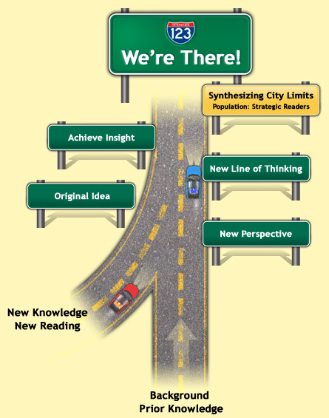
Good Readers Use Strategies
Background knowledge
Questioning
Inference
Determining importance
Create mental images
Fix Up Strategies
Synthesizing
From http://choiceliteracy.com/articles-detial-view

Slide 7
What is Active Reading?
reading with a purpose
looking for information
relating new knowledge to old knowledge
Finding patterns and connections
asking questions about the text.

Slide 8
Activity
Read the poem labeled hand-out 2 with a partner.
As you read, use the post-it notes to write at least one question you have about the poem.
Read the poem again. This time use the post-it notes to record any connections you have to the poem.
Connections include:
This reminds me of . . .
This is similar to . . .
That makes me think of . . .

Slide 9
Active Reading
Connecting helps activate background knowledge
Questioning allows readers to interact with the texts
Novice readers need to understand that meaning is constructed
Allowing students to make connections and ask questions requires students to actively participate while reading
Only through active participation will students eventually develop meta-cognitive strategies

Slide 10
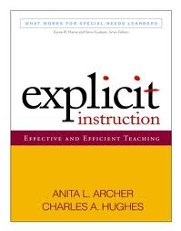
What is Explicit Instruction?
In the book Explicit Instruction: Effective and Efficient Teaching by Anita Archer and Charles Hughes, explicit instruction is described as systematic, direct, engaging, and success oriented—and has been shown to promote achievement for all students

Slide 11
Activity
My neighbor has lost her dog and has asked me to help her make some posters to hang around town.
Maybe you can help me make some posters before we leave today.
I have a list of things my neighbor has told me about her dog. However, there is too much information for me to list it all on a poster.
Let’s pull out what is most important before we make posters.

Slide 12
Information about Sonny
4 years old
Eats Purina One food
Blue collar
Favorite toy is a stuffed squirrel
Likes kids
Last seen at school playground
Has a tag labeled Sonny
Wags his tail a LOT!!
Likes to cuddle
Likes to hide in small places
Know how to sit, stay, and lie down
Has ridden in a plane 5 times
Smallest puppy in the litter

Slide 13
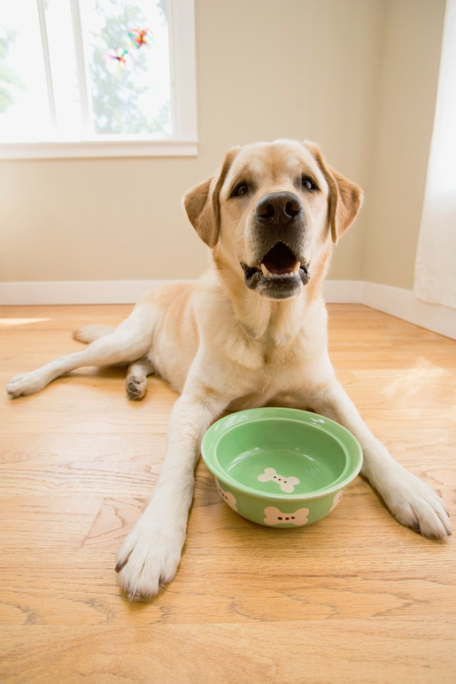
Lost Dog
Blue collar
Has a tag labeled Sonny
Last seen at school playground
Likes to hide in small places
REWARD
Please call 940-686-0000
Anchor Lesson from Texas Literacy Institute

Slide 14
Questions?
Please take a moment to fill out the evaluation form.
Door prize!!

Slide 15
Let’s sum it all up
How to engage readers
Active reading
Explicit instruction
Additional comments?
For your exit ticket, please write down how you will incorporate today’s activity in your classroom.
I will check in with you next week to see how it went!

Slide 16
Before you go
Evaluations
Exit Ticket
Please stack the evaluations in the center of the table.
I need these evaluations to receive credit for my course.
You can hand your exit ticket to me as you leave
Thank you for spending your afternoon with me!

